Slide 1


SMART INDIA HACKATHON 2024
TITLE PAGE
Problem Statement ID – SIH1702
Problem Statement Title- Bail Reckoner
Theme- Smart Automation
PS Category- Software
Team ID- 303
Team Name- NeoCodenex

Slide 2
IDEA TITLE
NeoCodenex
A bail reckoner is a valuable tool for the justice system, helping to ensure fairness and transparency in bail decisions. It utilizes data and algorithms to calculate a recommended bail amount, promoting objective and consistent decision- making.
KEY COMPONENTS
Data Collection: Compiling historical data on bail decisions is essential to establish a baseline for comparison.
Algorithmic Model: An advanced algorithmic model analyzes the collected data and risk assessments to calculate a recommended bail amount, taking into account individual circumstances.
Objective: The primary objective is to streamline and enhance the bail decision- making process in indian courts through the use of artificial intelligences

Slide 3
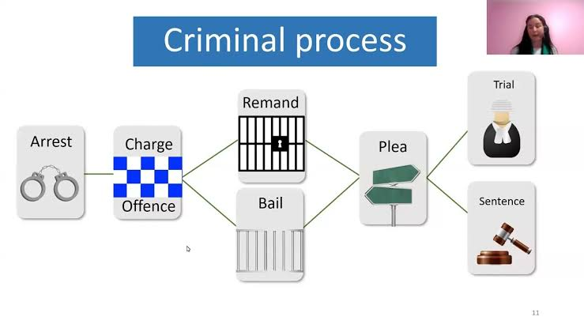
TECHNICAL APPROACH
NeoCodenex
Frontend: React.js, Tailwind CSS, Javascript
Backend: Node.js , Django
Database: Firebase
Authentication: JWT, OAuth2.0
Control: GitHub
Bail Reckoner Workflow

Slide 4
FEASIBILITY AND VIABILITY
NeoCodenex
Data Availability: There is sufficient data available from legal databases like NCRB, Indian Kanoon, and court records
Integration with E-Courts: The existing E-Courts Mission Mode Project provides a digital platform for managing court cases.
Acceptance by Legal Community: Judges and lawyers might be resistant to relying on a digital system for bail decisions.
Integration with Future Reforms: As judicial reforms continue, the bail reckoner can be adapted to align with any new laws or guidelines.
Potential challenges and risk
Judicial Hesitation: Judges may be resistant to relying on an AI-based system for decision-making.
Incomplete or Inaccurate Data: The success of the system relies on access to accurate and comprehensive legal data, which may not always be available.
Strategies to overcome these challenges
Engage Stakeholders Early Conduct workshops and training sessions with judges, lawyers, and court clerks.
Use machine learning techniques to fill gaps in missing data.

Slide 5

IMPACT AND BENEFITS
NeoCodenex
IMPACT
Reduction in Pre-Trial Detention.
Protecting personal liberty.
Strengthened Public Trust in the Judicial System
Reduced Perception of Bias
BENEFITS
Efficiency: Accelerates bail decisions, reducing court backlogs.
Fairness: Ensures more consistent and unbiased bail outcomes.
Transparency: Increases public trust in the judicial process.
Human Rights: Protects individual rights by reducing unnecessary pre-trial detention.
Economic Impact: Lowers costs for courts, law enforcement, and defendants, and prevents job loss for detainees.

Slide 6

RESEARCH AND REFERENCES
NeoCodenex
Code of Criminal Procedure (CrPC): This is the law that governs the process of criminal trials in India, including the procedure for granting bail.
AI in Criminal Justice: Research papers on AI models in predictive justice and legal decision-making.

